Slide 1
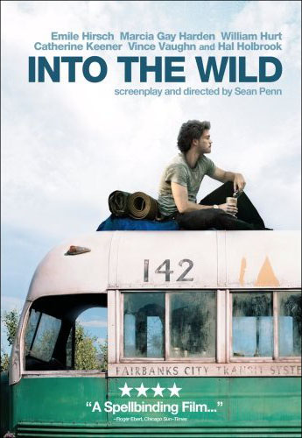
Stage 2 English 2017
1000 word essay
How does Director Sean Penn of 2007 film ‘Into The Wild’ explore the idea of…
freedom and independence
isolation and loneliness
humans and nature
family
Survival
Truth
and how does this impact on the audience?
Or
How does the director communicate a theme of your choosing, and how does this influence the audience?

Slide 2
Food for Thought…
Was Christopher selfish or noble? What makes you think this?
Was he escaping society or his family? What makes you think this?
Can we really KNOW what he felt and thought?
What did Christopher come to realise by the end? Did he?
Does he die as Christopher McCandless or Alexander Supertramp?

Slide 3
Performance Standards
Assessment Design Criteria | What they mean
KU1 COMPREHENSIVE Knowledge and understanding of ideas and perspectives in texts. | Comprehension of themes
KU2 Knowledge and understanding of ways in which authors use language features, stylistic features, and conventions to make meaning. | Stylistic features = genre and techniques Stylistic elements of film include; - The Narrative; Plot and Events - Characterisation and Acting - Sound - Editing - Cinematography; angles, shots, composition. - Mise en Scene: lighting, costume, setting - Genre Conventions = Make meaning = communicate a point or message about the theme/consider: what is the point of the text? Why is it important?
An1 Analysis of language features, stylistic features, and conventions, and evaluation of how they influence audiences. | The effect of language, style and convention on the audience
An2 Analysis and evaluation of ways in which ideas, perspectives, and/or aspects of culture are represented in texts. | Which techniques are used to portray/explore theme ? How effective were they?
Ap2 Use of evidence from texts to develop and support a response. | Integrated, appropriately punctuated quotations and captioned screenshots to illustrate a point.

Slide 4
Film Details and Synopsis
Directed by Sean Penn, 2007.
Adapted from the novel by journalist John Krakauer, who traced the last months of Christopher McCandless’ journey, interviewing the people he had met and using excerpts from Chris’ journal and literary textss.
Into the Wild tells the true story of Chris McCandless, a young man from a troubled family who was enraged by the moral lapses of his mother and father and their multiple failures as parents. McCandless also had a love of nature and adventuring in the wild. Upon graduating near the top of his class from college, McCandless cut himself off from family and friends to go solo adventuring in the Western United States. His last trip was to the Alaskan wilderness where he was found dead of starvation in an abandoned bus. The movie tells the story of the events at home, McCandless' love of nature, his wanderings in the West, the people that he met, and in the final weeks, his epiphany of forgiveness and realization of the importance of human relationships. McCandless' journey was investigated by John Krakauer, a writer for Outdoor Magazine, who tracked the young man's travels seeking to understand both his motives for going on the road and the cause of his untimely death.

Slide 5
Life Lessons – not necessarily themes – just lessons
Into The Wild provides important life-lessons that:
(1) risky behaviour can have fatal consequences;
(2) parents need to be careful in raising their children;
(3) there are times when children need to forgive their parents;
(4) happiness and beauty must be shared to be fully enjoyed;
(5) relationships with people are an essential part of life.

Slide 6
Possible Questions
How does the Director of ‘Into The Wild’ explore the idea of…
freedom and independence
isolation and loneliness
humans and nature
family
survival
truth
and how does this impact on the audience?
Explore = 2 or 3 techniques (e.g. editing, soundtrack)
Freedom, truth, etc… = choose one theme
impact on the audience = what they take away/think

Slide 7
Themes
Truth
freedom and independence
isolation and loneliness
humans and nature
Family
survival
Q: What events from the film make you think the director is commenting on this theme?
E.g. what events/techniques show Christopher searches/finds/doesn’t find for Truth?

Slide 8
Techniques
Technique | Effect on Viewer
Plot (events) | Sympathise…? Come to understand him…?
Editing (non-linear) | Diary / Memory-like > Impacts?
Cinematography: hand-held style | wide open landscape shots, close-in society shots = closed in / freedom?
Soundtrack: Eddie Vedder’s folksy music (acoustic and lyrics) | Folksy tune = freedom? Genre expectations of acoustic music.
Mise en Scene: costume, lighting, setting, design | Costume of ‘normies’ vs others Setting is harsh; ironic that he doesn’t fit into ature!
Characterisation (actions, etc) | (Builds a picture of Chris)
Narration | (Builds a picture of Chris)
Allusion | (Builds a picture of Chris)
Irony | (Events)

Slide 9
Plot
The plot, through non-linear editing, is told in a winding way..
This takes us on Chris’ journey
Has us identify with him
See the impact of his actions
The tragedy of his young death
The beauty of his realisation and growth?

Slide 10
Plot / Structure / Editing: Non-Linear
Non-linear narrative;
Nonlinear narrative, disjointed narrative or disrupted narrative is a narrative technique, sometimes used in literature, film, hypertext websites and other narratives, where events are portrayed, for example out of chronological order, or in other ways where the narrative does not follow the direct causality pattern of the events featured, such as parallel distinctive plot lines, dream immersions or narrating another story inside the main plot-line.
It is often used to mimic the structure and recall of human memory, but has been applied for other reasons as well.
Seems to cut between Chris’ experiences in the bus
And the formative experiences he shared with people on the way
This offers commentary –
His actions, e.g. leaving, have a devastating impact on the people he meets, hurting them.
e.g. at the end, near his death we see the lives of all the people he met; how they came to be and mostly suffer.

Slide 11
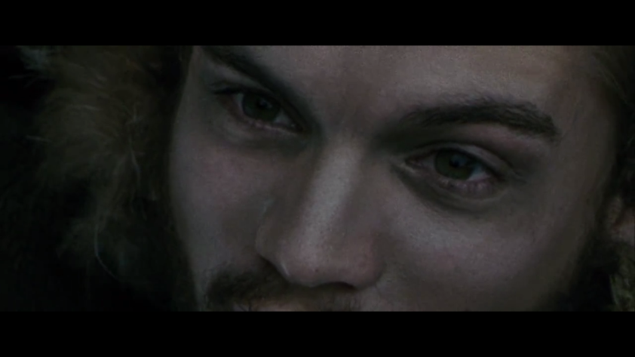
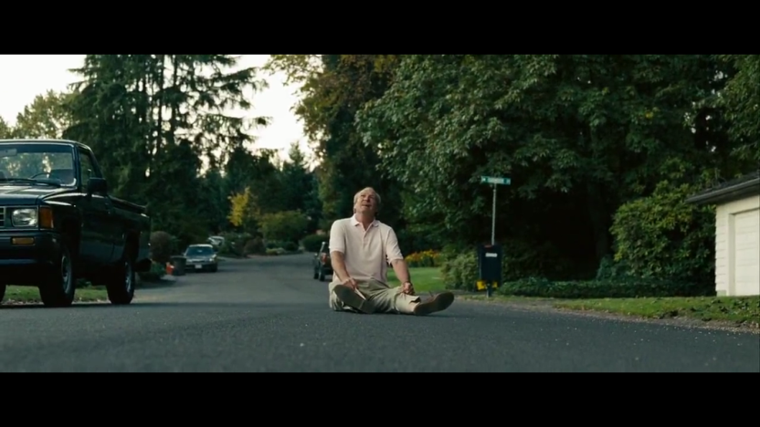
Editing
What does this contrast, through editing (selection and sequence of images and sounds), tell us about freedom? About loneliness? About truth?

Slide 12
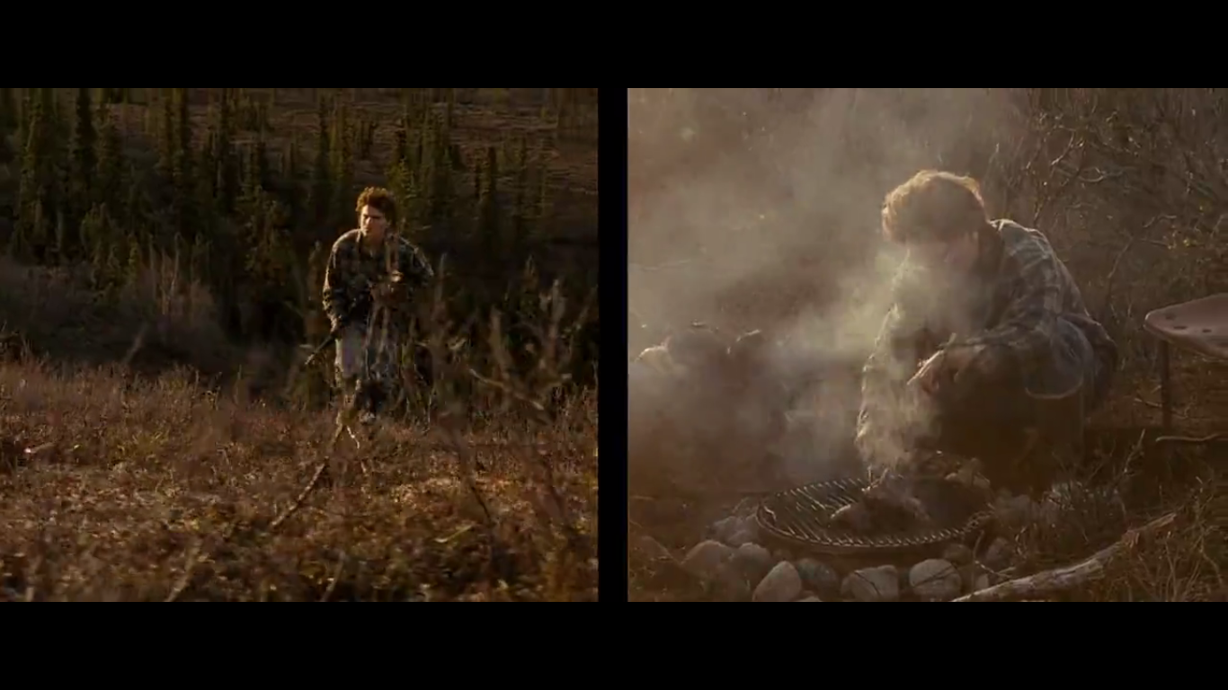
Editing

Slide 13
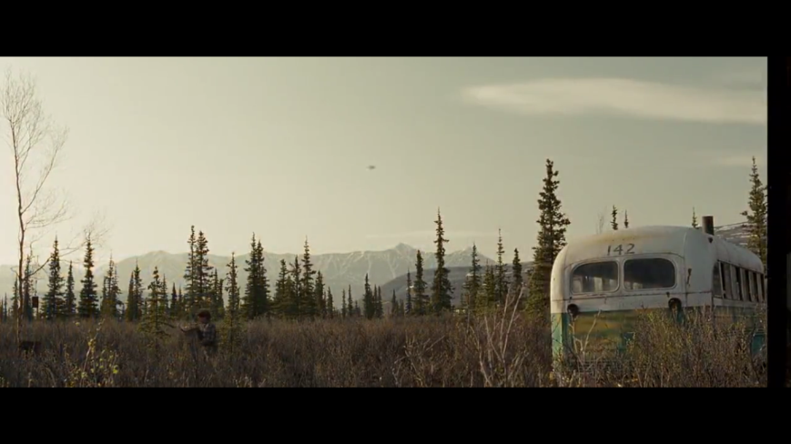
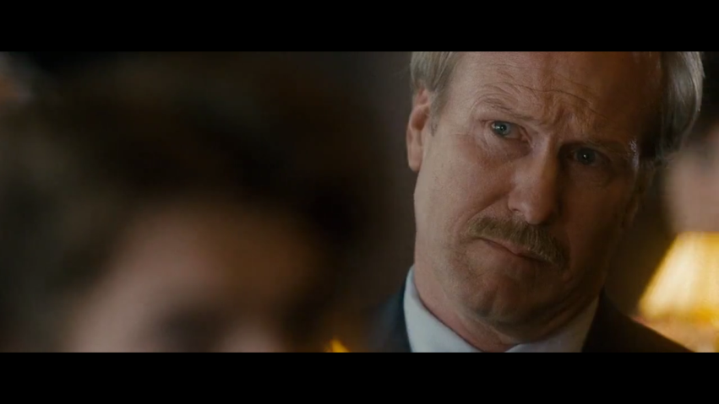
Cinematography
Camera shots
Camera angles
Frame composition
Tends to be wide, open shots of nature,
Sometimes sensory close-ups (out of focus)
Society tends to be closer in, e.g. when talking to parents the framing is tight.

Slide 14
Soundtrack
Eddie Vedder’s Soundtrack…
https://www.youtube.com/watch?v=T_K__3OKkFg
Hard Sun
When I walk beside her i am the better man when I look to leave her I always stagger back again once I built an ivory tower so I could worship from above and when I climbed down to be set free she took me in again there's a big a big hard sun beaten on the big people in the big hard world
Synthesis of imagery and sound = big impact, e.g. Chris dying and the music roaring (its lyrics revolving around nature and being part of society)

Slide 15
Literary Allusion: Characterisation Narration
In his book, Krakauer alludes to over a dozen authors, adventurers and philosophers in order to clarify the attributes of character that McCandless reveals in his relationships with the people he meets along the way as well as in his journals and postcards.

Slide 16
Literary Allusion pt2
The film begins with reference to English poet George Lord Byron's poem, "Child Harold’s Pilgrimage," written between 1812 and 1818.
Both Krakauer and the film's director, Sean Penn, felt that Byron's personal ethos expressed in these lines from his famous poem helped to describe the character of McCandless. Byron was known for creating the "Byronic Hero," a melancholy, defiant and troubled young man haunted by some mysterious transgression from his past.
The poem describes the travels and reflections of a world-weary young man who, disillusioned with a life of pleasure and revelry, looks for distraction in foreign lands. In a wider sense, it is an expression of the melancholy and disillusionment felt by a generation weary of the wars of the post-Revolutionary and Napoleonic eras. The title comes from the term childe, a medieval title for a young man who was a candidate for knighthood. The five lines referenced in the film are from canto iv, verse 178, as follows:
There is a pleasure in the pathless woods, There is a rapture on the lonely shore, There is society, where none intrudes, By the deep Sea, and music in its roar: I love not Man the less, but Nature more
? What sort of person do we imagine this character to be?

Slide 17
Irony
If choosing to use Irony in your essay as an umbrella technique, a number of techniques help indicate this.
Mostly plot, mise en scene and structure/editing.
E.g. Chris wants to be one with nature, but in what ways does nature reject him?

Slide 18
Setting?????

Slide 19
Into the wild is a film about relationships, not surviving the wild. Discuss, using techniques and impact on audience.
Characters as ‘Family’…
Jan as surrogate mother, upset he wont contact parents
Westerly as surrogate father, urges him to be careful, beware spring
Ron, offers to adopt him as grandchild, mentions “forgiveness”

Slide 20
The following themes are ideas to be picked apart, agreed with completely, completely refuted or somewhat proved true and false to a degree.
E.g. Christopher goes into the wild to find ‘ultimate freedom’, shown through the folksy soundtrack, open landscape cinematography and story; however we see that ‘ultimate freedom’ is not what he’d thought. He ironically realises…

Slide 21
Evidence: Screenshots with Captions
What constitutes evidence?
Screenshots of the film… In your text, “when Christopher dies, the camera floats away, (Fig. 1)”
With CAPTIONS! (these don’t count to Word Count!)
Fig. 1: The camera take on a floating movement, giving the viewer the space to reflect on Chris’ life and the impact of his actions on others.

Slide 22
Evidence: Quotations
You might quote the narrator – his sister, or Chris himself.
As Chris says via narration, “blah blah”, which shows the viewer…

Slide 23
Performance Standards Translation ‘A’
An ‘A’ Grade essay will…
Engage deeply with a theme from the film: Fully Agree, Disagree or argue it has elements you agree and disagree with – to what degree?
Yes, truth
Yes, truth
But Ironic treatment of truth

Slide 24
Possible Essay Structure
Intro
Body : Technique, examples, impact on viewer (agree with the theme/thesis)
Body 2: Technique, examples, impact on viewer (agree with the theme/thesis)
Body 3: Technique, examples, impact on viewer (Somewhat refute / disagree / completely agree with thesis?)
Conclusion: effectiveness

Slide 25
Stylistic Features:
C Grade: refer only to EVENTS from the film as loose evidence
B Grade: refer to EVENTS and A TECHNIQUE, eg. Cinematography, as evidence
A Grade: refer to a TECHNIQUE, e.g. Cinematography, sealessly explaining the director’s use of it in this scene, how it relates to the theme as a whole, how successfully it impacts on the viewer.
Perhaps even comparing, contrasting its use with another technique or another point in the film where it is employed.
In a paragraph you might even compare and contrast two events to prove a point… One from the beginning and one from the end to demonstrate the proptagonist’s emotional growth.

Slide 26
Sentence Starters
Use analytical starters…
Refer to the blue handout for ideas!

Slide 27
Further Ideas / Themes

Slide 28
The Allure of the Wilderness
To McCandless and many others of his ilk, the wilderness has a very specific allure. McCandless sees the wilderness as a purer state, a place free of the evils of modern society, where someone like him can find out what he is really made of, live by his own rules, and be completely free. And this is not just naïveté; McCandless's journal entries show that he does find some answers, some keys to living the way he wants to live.
Yet, it is also true that the reality of day-to-day living in the wilderness is not as romantic as he and others like him imagine it to be. McCandless spends so much time trying to find food to keep himself alive that he has little time to consciously appreciate the wilderness, as is evidenced by the fact that his journal consists almost solely of lists of the food that he finds and eats every day. Perhaps this explains why many of his heroes who wrote about the wilderness, for example, Jack London, never actually spent much time living in it.
How is this communicated? Some ideas…
Cinematography: wider shots of landscapes and nature contrasted with claustrophobic close-ups and tight composition when with family/society.
Irony: the allure of the wilderness holds for a time, but soon Christopher finds it rejects him. E.g. the moose being flyblown; river traps him
Soundtrack: Edie Vedder’s wistful, folk acoustic song ‘X’ playing over the scenes of travel or nature.

Slide 29
Forgiveness
Forgiveness, and the danger inherent in the inability to forgive, are central themes in Into the Wild. Chris McCandless is shown to be a very compassionate person, who is unwilling to ignore the fact that so many people are starving or hungry around him, and feels a personal responsibility to help them. Yet his actions are ultimately selfish, and do great harm to those who love him most. Moreover, his inability to forgive his parents’ mistakes seems to be at the center of this seeming contradiction between his compassionate nature and his sometimes cruel behavior.
There is certainly more behind his odyssey than just anger at his parents, but his resentment of them does spread into the rest of his life, and seems to be closely connected to how isolated he becomes at Emory. This, in turn, adds to his revulsion against society generally, which is clearly a driving factor in his deciding to go into the wilderness. One is left to wonder if, had McCandless found a way to forgive his parents for their shortcomings, he would not have felt the need to go to such extreme lengths in his quest for answers.
How is this communicated? Some ideas…
Non-linear structure via editing: contrasts his ‘Bus’ scene with formative experiences with people. When he is dying, we see the impact his selfishness has had on those people e.g. Dad collapsing, Ron sad, etc.
Chapter Titles: based on the book’s chapter names. These trace Christopher’s growth. E.g. Chapter 1 “blah” and the events that follow…

Slide 30
Ultimate Freedom
Isn’t ultimate… / is unfulfilling / etc, etc
McCandless describes what he is looking for on his odyssey, particularly on the Alaska trip, as “ultimate freedom.” It would seem that this largely represents, to him, freedom from other people’s rules and authority over him. Throughout his whole life he finds authority particularly oppressive, especially when exercised by anyone who he feels only has such power over him for arbitrary reasons. To live completely alone, in a world where the only laws he feels the need to follow are those of nature, is to him ultimate freedom.
Yet this level of freedom requires total isolation, for to be with others means to have obligations to them. Thus, McCandless’s quest for freedom becomes, also, a refutation of any and all intimacy with others. This kind of freedom is inherently selfish. By living only according to his own rules and those of nature, no matter how principled and deeply-thought, McCandless is implicitly living only for his own best interest.
How is this communicated? Some ideas…
Literary Allusion – certain texts mentioned allude to ideas of ultimate freedom, notably Thoreau.
Events/Plot - For example, he refuses to get a hunting license because he doesn’t think it is any of the government’s business what he eats; were everyone to act this way, animal populations would be destroyed, and food supplies threatened. McCandless's ultimate freedom is thus limited in scope, for on any larger scale it would be dangerous and potentially disastrous.

Slide 31
The Allure of Danger
…is a positive thing / negative thing
The allure of danger and high-risk activities is central to Into the Wild. Krakauer does not believe that this allure is significant to everyone, but it certainly is to a specific kind of young man -- one who is intense, passionate, driven and ambitious, but not satisfied with the opportunities or challenges society presents to him. These young men also always seem to have some kind of demon driving them, whether it is a troubled relationship with their fathers, as with McCandless, Krakauer, and John Waterman, or something else.
For Krakauer, at least, the risk in his activities brought him to a point of meditation—because he is often only one mistake away from death, he has to focus utterly, and this allows him to escape from those problems that would otherwise eat away at him. There is also the thrill of pure accomplishment, man against only nature and himself, which allows him to feel that he truly knows what he is capable of, that he doesn’t need to rely on others, or on society, to survive.
How is this communicated? Some ideas…

Slide 32
Valuing Principles over People
One of the primary qualities McCandless constantly exhibited, which in turn led many to respect him, was his adherence to principles. He does not simply preach that his parents are too materialistic, or state that he won’t be as greedy as he believes them to be. Instead, he lives by his anti-materialism completely, giving away all of his life savings to charity, only making the bare minimum of money that he needs to survive, and keeping as few possessions as he possibly can.
While this adherence to principle is admirable and, unfortunately, unusual, McCandless does seem to put his principles above people, which leads him to cause hurt without really intending to do so. For example, in college Chris decides that he has a moral problem with gifts, and so will no longer accept or give them. Although this decision is based on a sense of morality, it in fact causes McCandless to hurt those who care about him. This may be related to his intimacy problems, for as long as he doesn’t let people get too close, he won’t be put in a position of having to choose them over his principles.

Slide 33
The Elusiveness of Identity
The elusiveness of identity, or of truly understanding someone’s identity, is a theme both explicitly and implicitly present throughout Into the Wild. Krakauer spends about three years putting together first the article on Chris McCandless, and then this book. He talks to almost anyone who met McCandless, even fleetingly. He follows McCandless's trails, reads his journals, even reads the articles he wrote for the student paper at Emory. Krakauer also feels he has an extra level of understanding, because he was much like Chris when he was in his twenties.
Yet even with all of this, at the end of the book, Krakauer acknowledges that McCandless’s presence remains elusive. As closely as he may have studied him, as well as he has come to “know” him, there are a few fundamental questions which no one, not even Chris’s parents, can find a satisfactory answer to. Most important of these is how someone so compassionate, kind, and intelligent could have ended up devastating his parents, and all of those who loved him, so profoundly. The ultimate inability to truly know another person is thus at the heart of Into the Wild.

Slide 34
The Father-Son Relationship
The father-son relationship, and the potential for dysfunction within it, is an important theme in Into the Wild. McCandless is highly ambitious, and has a highly ambitious father. The problem arises in that his fathers’ ambitions for him are very different from his own, and his strong will and passion for his own kind of ambition, the wilderness and anti-materialist living—cause great rifts between the father and son.
For McCandless, the combination of trying to please a difficult-to-please father, resenting authority, and discovering their fathers’ own great failings leads to an almost insurmountable rift. McCandless died before he had the opportunity to grow out of his anger.

Slide 35
Huge thanks to the resources:
https://sites.google.com/site/intothewildfilmstudy/home/themes

